Slide 1

EDR100
Electrical Drivelines 1
HT2023
Danyang Cui
Lecture 5

Slide 2
Course outline
Course intro, tools, getting started with simulations
Vehicle behaviors and simulation tricks, drive cycles
Simulation of Electric Machine with MotorCAD data
Simulation of Power Electronics and Battery
Full vehicle behavior, final assignment

Slide 3
Lecture 5 outline
Scaling of components
  PEC
  EM
  Battery
New/different vehicles
New/different drive cycles
Assignment 5

Slide 4
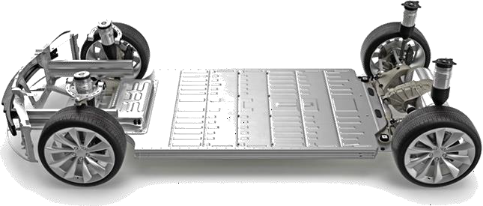
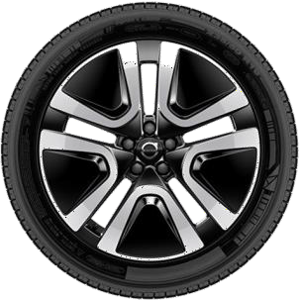
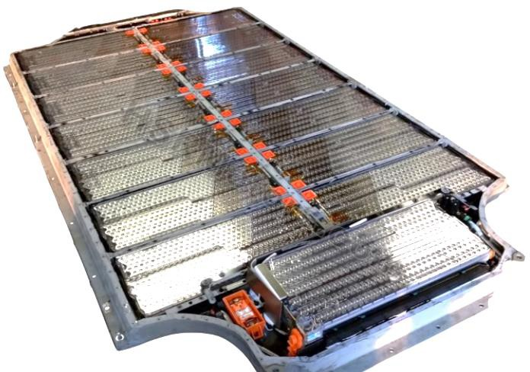
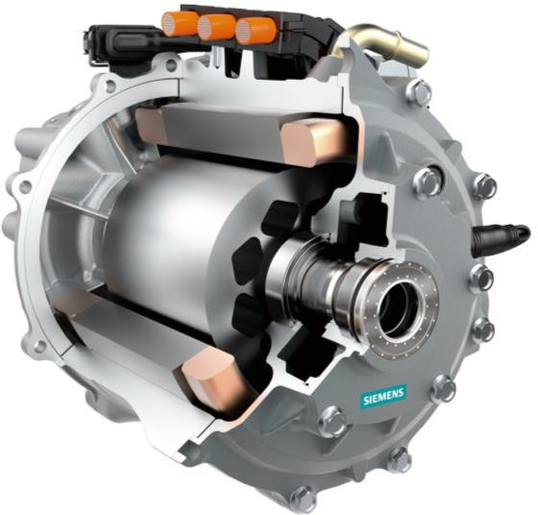
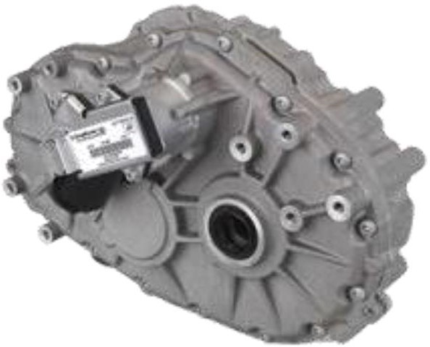
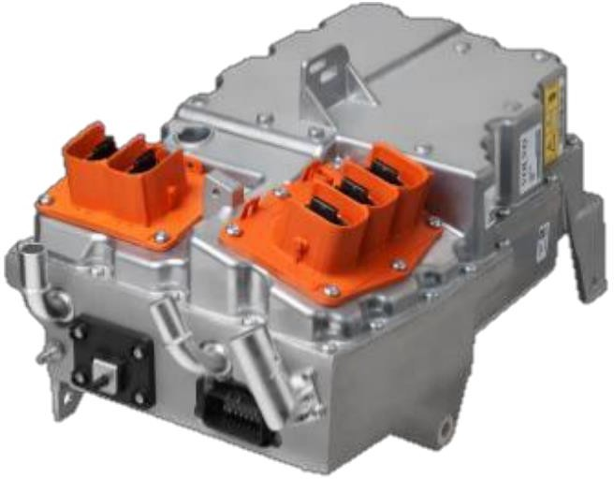
Electrical Drive Systems
Tire(s)
Image courtesy: Volvo Cars
RESS
(Battery)
PEC
(Power Electric Converter)
EM
(Electric machine)
GB + DIFF
(Gearbox & differential)
Image source: EV Tech Explained
Image courtesy: BorgWarner
Image courtesy: Siemens
Image courtesy: BorgWarner

Slide 5
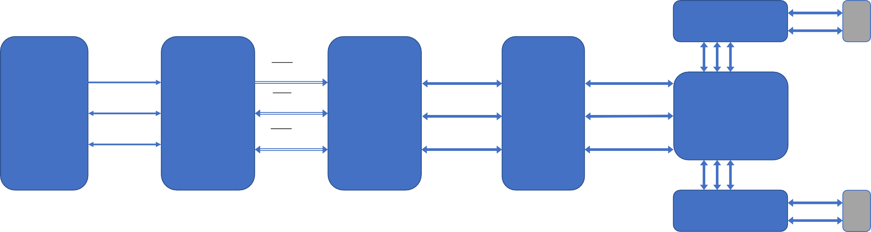
System overview
(max performance limits)
Electrical
Mechanical
Power, Speed, Torque, Force
Real Power Voltage Current
Complex Power
3xVoltage 3xCurrent
Frequency Amplitude Phase delay
𝐹_{𝐿} (N)
Wheel
Road
Ω (rad/s)
𝑣_{𝐿} (m/s)
𝐿
𝜏_{𝐿} (Nm)
𝑃_{𝐿} (W)
𝑉_{𝐷𝐶} (V)
𝑉_{𝐴𝐶} (V)
Ω_{𝐸𝑀} (rad/s)
Ω_{𝐺𝐵} (rad/s)
𝐼_{𝐷𝐶} (A)
𝑃_{𝐷𝐶} (W)
3x
𝐼_{𝐴𝐶} (A)
τ_{𝐸𝑀} (Nm)
τ_{𝐺𝐵} (Nm)
Battery
system
Inverter
Electric
Machine
Gearbox
Differential
3x
𝑆_{𝐴𝐶} (VA)
𝑃_{𝐸𝑀} (W)
𝑃_{𝐺𝐵} (W)
3x
Ω_{𝑅} (rad/s)
𝜏_{𝑅} (Nm)
𝑃_{𝑅} (W)
𝐹_{𝑅} (N)
Wheel
Road
𝑣_{𝑅} (m/s)
Electric drive: DC in, torque out

Slide 6
Scaling of PEC
Image courtesy: BorgWarner

Slide 7
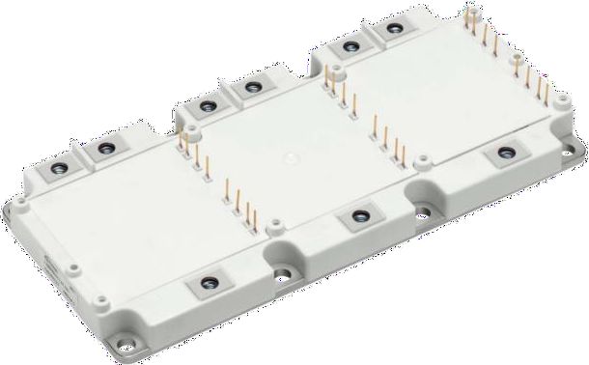
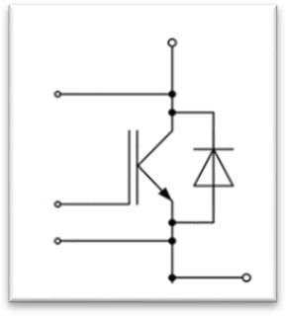
Scaling of PEC in Simulink
Image courtesy: BorgWarner
Scaling of PEC in Simulink model
Parameter “PEC_scaling” in init-file
  Scales the internal resistance of the IGBT transistors and diodes ➔ Lower conduction losses
  Scales the maximum current
PEC_scaling = 2 means:
  Twice the size of transistors working in parallel
  “Two inverters in parallel”, effectively sharing the
EM current equally and reducing the losses
Image courtesy: Infineon
Image courtesy: Infineon

Slide 8
Scaling of PEC
What happens if only the PEC is scaled, with total losses?
What determines the minimum PEC scaling to be used?
  Maximum current
What determines the maximum PEC scaling to be used?
  Secondary effects not presented in Simulink model, e.g. cost, size, weight

Slide 9
Scaling of EM
Image courtesy: Siemens

Slide 10
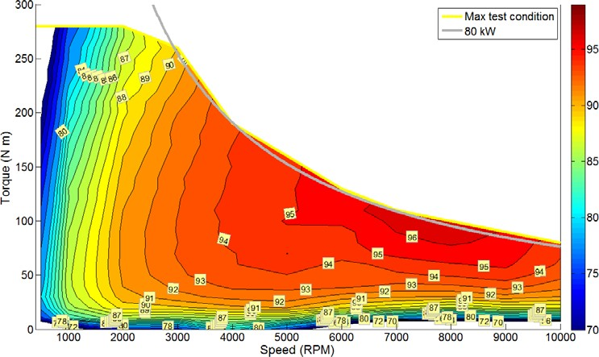
Scaling of EM
EM_scaling will scale the
EM’s torque capability, but leave the speed characteristics and max power unchanged
This corresponds to changing the length of the EM
Scaling the EM will make the same output power (but different torque and speed) have a different efficiency
EM_scaling
Scaling = 0.5

Slide 11

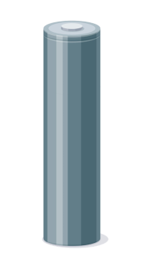


Scaling of Battery System

Slide 12
Battery system scaling
Feel free to experiment with:
Cell charge capacity (ESS_cell_Qmax)
  To scale charge- and energy capacity of individual cells
  Secondary effect: Larger capacity in cells means more mass, see ESS_cell_mass
Parallel connection of cells (ESS_cells_parallel)
  To scale charge- and energy capacity of system
Cell internal resistance scaling (ESS_cell_R_scaling)
  To scale battery losses, and indirectly; current limits
  Secondary effects (not in Simulink model): Lower resistance will need bigger, heavier and more expensive cells
Cell max/min current limits (ESS_cell_Cvalue)
  To scale maximum power capacity
  Secondary effects (not in Simulink model): Higher C-value will need bigger, heavier and more expensive cells
What NOT to change (not the scope of this course)
System voltage (stay with 400 V max)
Cell OCV curve

Slide 13
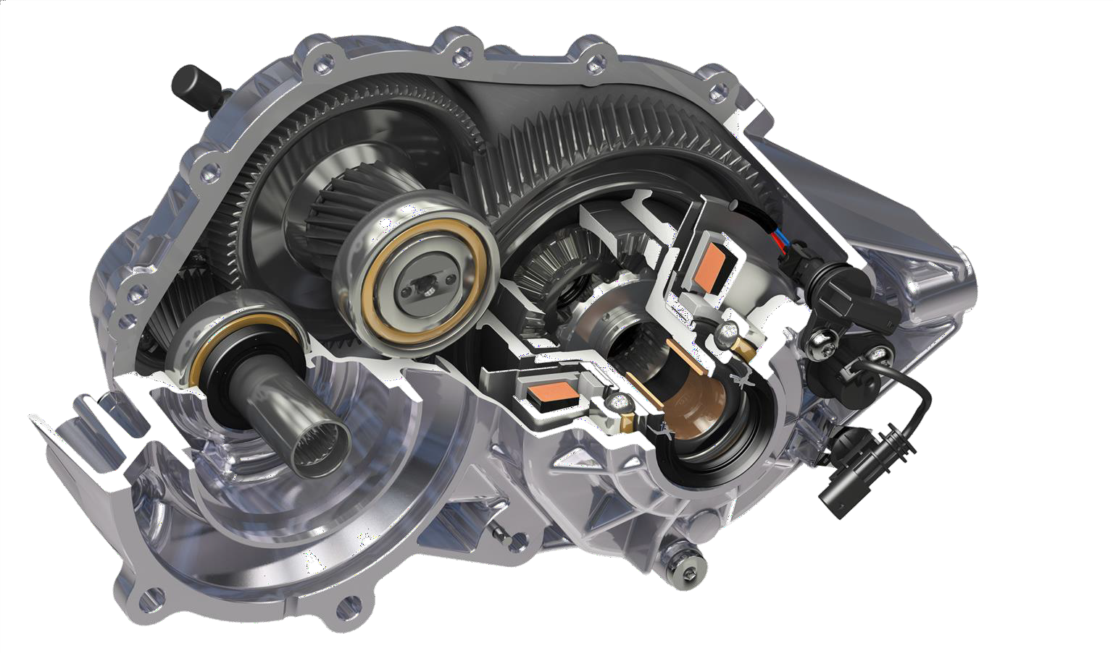
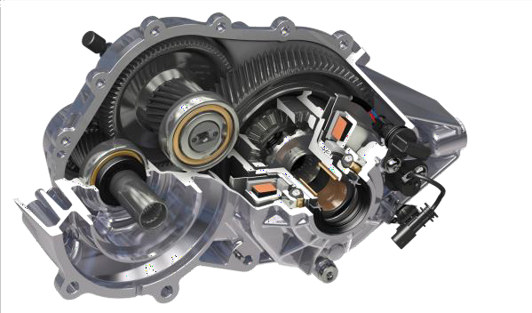
Gearbox scaling
Image courtesy: GKN
Image courtesy: GKN

Slide 14
Gearbox scaling
Feel free to experiment with:
Gear ratio (gear_ratio)
Gearbox efficiency (eta_gear)
  To add or decrease gearbox losses
Remember to check for boundary conditions, e.g:
What is the maximum speed the vehicle can drive with the EM limits?
Can the EM deliver the maximum torque needed?

Slide 15
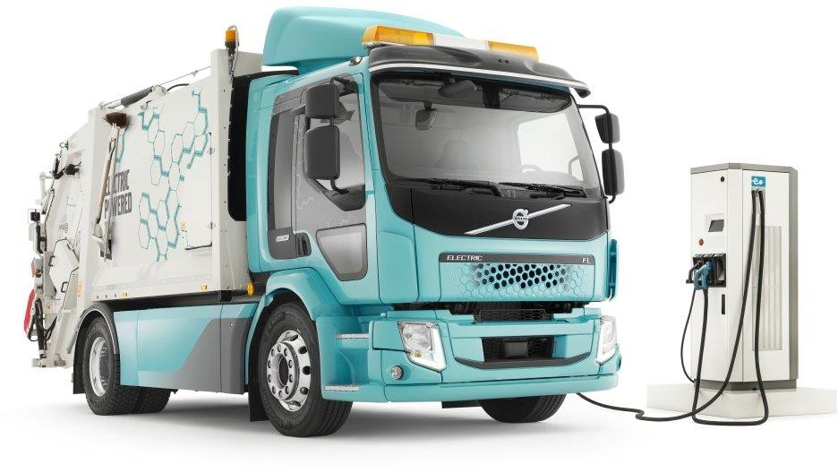
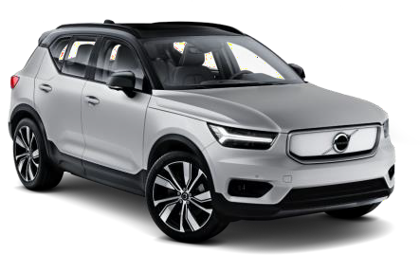
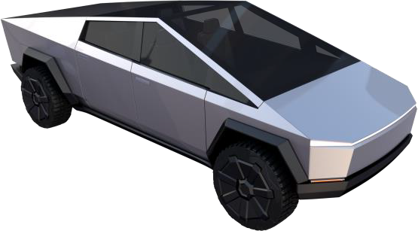
Vehicle parameters

Slide 16
Vehicle parameters
Feel free to experiment with:
Vehicle mass (m_v)
Wheel effective diameter (d_wheel)
Wheel rolling resistance (c_r)
Aerodynamic frontal area (A_f)
Aerodynamic drag coefficient (c_d)
Reference parameters from Lecture 1 and Assignment 4
Parameter | Reference car | Medium Truck
m_v (kg) | 1 700 | 6 000
d_wheel (m) | 2.101/pi*0.97 | 2.101/pi*0.97
c_r (-) | 9.0*10⁻³ | 9.0*10⁻³
A_f (m^2) | 2.3 | 5.0
c_d (-) | 0.28 | 0.6

Slide 17
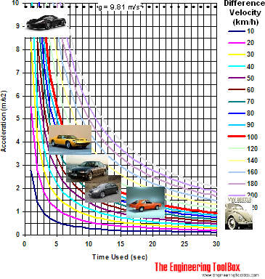
Drive cycles
So far, we have used WLTC for simulation. What if we use another drive cycle?
How will it affect energy consumption?
How will it affect component efficiency?
Examples of acceleration times for production cars
(https://www.engineeringtoolbox.com/car-acceleration-d_1309.html)
Think about making your own drive cycle or “mission profile”, e.g:
0-100 km/h acceleration
Decide what 0-100 km/h time to achieve (dt)
Calculate average acceleration a = dv/dt
Make your own speed profile with a ramp from 0-100 km/h

Slide 18
Assignment 5
Parameter analysis using Simulink Model 4
See Word-template in Canvas.

